Slide 1


Elements and Components
Muhammad Zahir Junejo

Slide 2


Lecture - Housekeeping
The use of disrespectful language is prohibited in the questions, this is a supportive, learning environment for all - please engage accordingly.
Please review Code of Conduct (in Student Undertaking Agreement) if unsure
No question is daft or silly - ask them!
Q&A session at the end of the lesson, should you wish to ask any follow-up questions.
Should you have any questions after the lecture, please schedule a mentor session.
For all non-academic questions, please submit a query: www.hyperiondev.com/support
Notes:
A data structure is a particular way of organizing data in a computer so that it can be used effectively.

Slide 3


Basics of React.js Projects
Creating elements
Creating components
What is the JSX Syntax?
Learn about props
Lecture Objectives

Slide 4
React
Web developers often use libraries and frameworks to create web applications more quickly.
React.js or React is a JavaScript library used for frontend development.
With React, we use JavaScript to write HTML. Therefore it is easy to mix up logic and calculations with the HTML.
JSX: JavaScript XML. JSX is a JavaScript extension syntax that helps to write HTML and JavaScript together easily.
React Elements: Building blocks of React applications.
Components: Reusable pieces of code that return an element to render to the page.
Props: Inputs to a React component.
State: Object that holds data related to a Component.
Notes:
A data structure is a particular way of organizing data in a computer so that it can be used effectively.

Slide 5
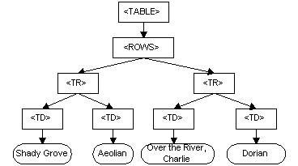
Virtual DOM
The DOM is a programming API for HTML documents that defines the logical structure of documents and how they are accessed and manipulated.
We can add or remove element from an HTML page using JavaScript, thanks to DOM.
Notes:
A data structure is a particular way of organizing data in a computer so that it can be used effectively.

Slide 6
Virtual DOM
Rewriting the DOM every time the HTML document changes can significantly slow down your web application or site. To address this problem, React uses a virtual DOM.
Virtual representation of the HTML document in memory.
Works by taking a snapshot of the DOM before changes are made.
As changes are made, the virtual DOM is updated.
After the changes are complete, the virtual DOM and the snapshot of the DOM (which is also saved in memory) are compared to see where changes were made.
Instead of rewriting the entire DOM, the real DOM is only updated with the changes that were made.
Notes:
A data structure is a particular way of organizing data in a computer so that it can be used effectively.

Slide 7
Elements
Through elements, you basically tell React what you want to see on the screen.
React elements are similar to DOM elements.
Not used directly, instead they are returned from Components.
Creating React elements:
Create the React and ReactDOM objects by importing React and React-DOM
Create the React element using JSX
Place the React element on the render function of the component.
Notes:
A data structure is a particular way of organizing data in a computer so that it can be used effectively.

Slide 8
JSX
JavaScript Syntax Extension referred to as JavaScript XML.
Makes creating React application a lot easier.
JSX tags have a tag name, attributes and children.
If an attribute value is enclosed within quotes (“”) it is a string literal however if the attribute value is wrapped by curly brackets ({}), it is considered an enclosed JavaScript expression.
Notes:
A data structure is a particular way of organizing data in a computer so that it can be used effectively.

Slide 9
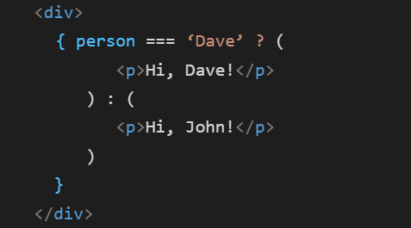
Conditional Rendering
Rendering an element or elements on the basis of a condition.
Example:
Notes:
A data structure is a particular way of organizing data in a computer so that it can be used effectively.

Slide 10
Rendering arrays
You can use the Array.map(...) function to render lists to the page.
Example:
let gameList = [“cricket”, “football”, “badminton”];
<div>
{ gameList.map( ( item, index ) => {
return (
<li key = { index } > { item } </li>
)
})
}
</div>
Notes:
A data structure is a particular way of organizing data in a computer so that it can be used effectively.

Slide 11
Props
React components use props to communicate with each other.
Every parent component can pass some information to its child components by giving them props.
Props might remind you of HTML attributes, but you can pass any JavaScript value through them, including objects, arrays, and functions.
Notes:
A data structure is a particular way of organizing data in a computer so that it can be used effectively.

Slide 12
Props
Props let you think about parent and child components independently. You can think of props like “knobs” that you can adjust.
Passing props:
<Avatar
person={{ name: 'Lin Lanying', imageId: '1bX5QH6' }}
size={100} />
Reading props:
function Avatar(props) {
let person = props.person;
let size = props.size;
}
Notes:
A data structure is a particular way of organizing data in a computer so that it can be used effectively.

Slide 13


Questions and Answers

Slide 14
References
https://react.dev/learn/your-first-component
https://react.dev/learn/importing-and-exporting-components
https://react.dev/learn/writing-markup-with-jsx
https://react.dev/learn/javascript-in-jsx-with-curly-braces
https://react.dev/learn/passing-props-to-a-component
https://react.dev/learn/conditional-rendering
https://react.dev/learn/rendering-lists
Notes:
A data structure is a particular way of organizing data in a computer so that it can be used effectively.

Slide 15
Thank You!

